Slide 1
the Global Harmonisation Task Force and its purpose
Global Harmonization Task Force
Rationale
Members
Vision
Activities
17.3.3 Describe the Global Harmonisation Task Force and its purpose
Unit C 17.3 Global Medical Equipment Regulations
Module 279-17-C Regulations, Standards and Ethics
dr. Chris R. Mol, BME, NORTEC, 2015

Slide 2
International Harmonization of Regulations: rationale
Medical devices are used worldwide. With the rapid growth in the global market for medical devices, there is a need to harmonize national standards in order to minimize regulatory barriers, facilitate trade and improve access to new technologies.
Harmonization also reduces the cost of implementing regulations for governments and local industry.
©
Government Regulatory Agencies
dr. Chris R. Mol, BME, NORTEC, 2015

Slide 3
International Harmonization of Regulations
the Global Harmonization Task Force, founded in 1993, was a voluntary international group of representatives from medical device regulatory authorities and trade associations from Europe, the United States of America (USA), Canada, Japan and Australia.
The purpose of the GHTF was to encourage a convergence in standards and regulatory practices related to the safety, performance and quality of medical devices.
The primary way in which the GHTF achieves its goals is through the production of a series of guidance documents that together describe a global regulatory model for medical devices. These documents can then be adopted/ implemented by member national regulatory authorities or others.
Eliminating differences between jurisdictions decreases the cost of gaining regulatory compliance and allows patients earlier access to new technologies and treatments.
The organisation GHTF no longer exists (since end-2012), and has been replaced by the IMDRF
©
Government Regulatory Agencies
dr. Chris R. Mol, BME, NORTEC, 2015

Slide 4
International Harmonization of Regulations: IMDRF
The International Medical Device Regulators Forum (IMDRF) was set up in 2011 as a forum to discuss future directions in medical device regulatory harmonization.
IMDRF is a voluntary group of medical device regulators from around the world who have come together to build on the strong foundational work of the Global Harmonization Task Force on Medical Devices (GHTF), and to accelerate international medical device regulatory harmonization and convergence.
see: http://www.imdrf.org/
©
Government Regulatory Agencies
dr. Chris R. Mol, BME, NORTEC, 2015

Slide 5
IMDRF Members
The current members are:
Australia Therapeutic Goods Administration
Brazil National Health Surveillance Agency (ANVISA)
Canada Health Canada
China China Food and Drug Administration
European Union European Commission Directorate-General for Internal Market, Industry, Entrepreneurship and SMEs
Japan Pharmaceuticals and Medical Devices Agency and the Ministry of Health, Labour and Welfare
Russia Russian Ministry of Health
USA US Food and Drug Administration
The World Health Organization (WHO) and the APEC LSIF Regulatory Harmonization Steering Committee are
Official Observers.
The Asian Harmonization Working Party (AHWP) and the Pan American Health Organization (PAHO) are
IMDRF Affiliate Organizations.
©
Government Regulatory Agencies
dr. Chris R. Mol, BME, NORTEC, 2015

Slide 6
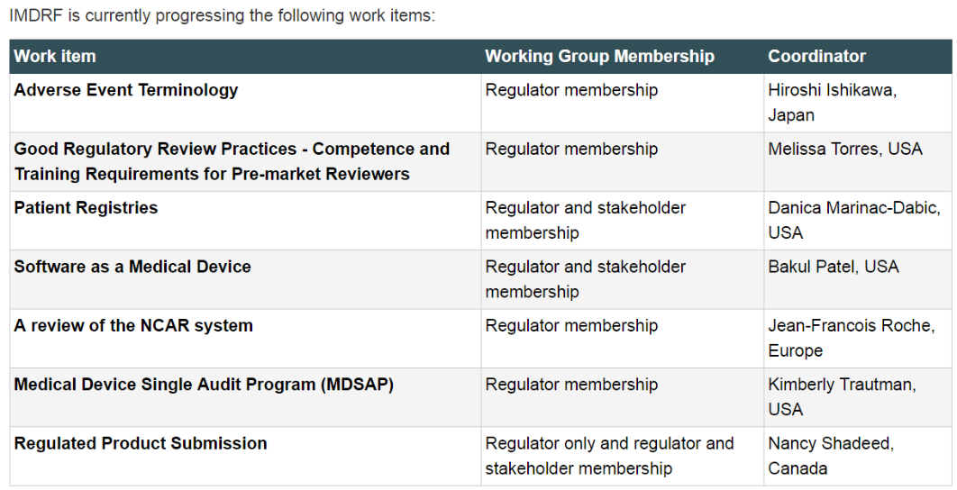
IMDRF: current work
this list is here only to see what sort of things the IMDRF is doing….
©
Government Regulatory Agencies
dr. Chris R. Mol, BME, NORTEC, 2015

Slide 7
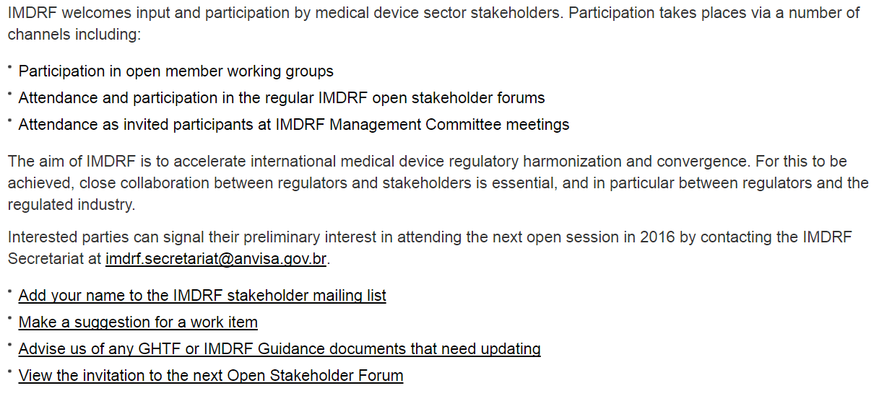
IMDRF: want to join?
©
Government Regulatory Agencies
dr. Chris R. Mol, BME, NORTEC, 2015

Slide 8
END
The creation of this presentation was supported by a grant from THET:
see https://www.thet.org/

